Slide 1
WEB DEVELOPMENT USING RUBY ON RAILS & POSTGRESQL
Ashwini Bhandary

Slide 2
UNIT I
Web Fundamentals & Getting Started with Rails

Slide 3
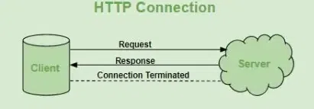
Web architecture is primarily built on the Client-Server model, where communication occurs through a structured Request-Response cycle using the HTTP protocol

Slide 4
Hypertext Transfer Protocol - HTTP
HTTP (Hypertext Transfer Protocol) is a fundamental protocol of the Internet, enabling the transfer of data between a client and a server.
It is the foundation of data communication for the World Wide Web. HTTP provides a standard between a web browser and a web server to establish communication.
It is a set of rules for transferring data from one computer to another.

Slide 5
History of HTTP
Tim Berners-Lee and his team at CERN are indeed credited with inventing the original HTTP protocol.
HTTP version 0.9 was the initial version introduced in 1991.
HTTP version 1.0 followed in 1996 with the introduction of RFC 1945.
HTTP version 1.1 was introduced in January 1997 with RFC 2068, later refined in RFC 2616 in June 1999.
HTTP version 2.0 was specified in RFC 7540 and published on May 14, 2015.
HTTP version 3.0, also known as HTTP/3, is based on the QUIC protocol and is designed to improve web performance.

Slide 6
Features
Stateless: Each request is independent and the server doesn't retain previous interactions' information.
Text-Based: Messages are in plain text, making them readable and debuggable.
Client-Server Model: Follows a client-server architecture for requesting and serving resources.
Request-Response: Operates on a request-response cycle between clients and servers.
Request Methods: Supports various methods like GET, POST, PUT, DELETE for different actions on resources.

Slide 7
HTTP Request Methods
Methods specify the action to be performed on a resource:
GET: Retrieve data (e.g., loading a webpage).
POST: Submit new data to be processed (e.g., a login form).
PUT: Replace an entire existing resource with new data.
PATCH: Update specific parts of an existing resource.
DELETE: Remove a specified resource.
CONNECT: Used to establish a tunnel to the server through an HTTP proxy, commonly used for SSL/TLS connections.

Slide 8
HTTP Status Codes
Codes indicate the outcome of the request:
200 OK: Success.
301 Moved Permanently: Resource has been moved to a new URL.
400 Bad Request: Client-side error (malformed request).
404 Not Found: Resource does not exist.
500 Internal Server Error: Server-side failure.

Slide 9
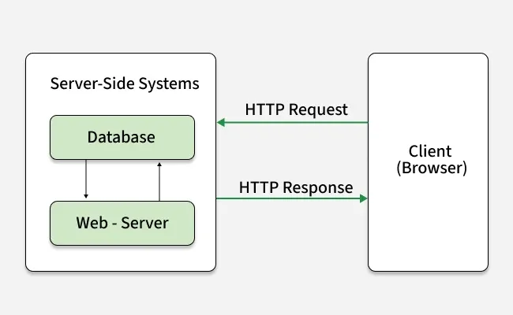
HTTP Request/Response:

Slide 10
Client sends an HTTP request: The client (usually a web browser) initiates the process by sending an HTTP request to the server. This request includes a request method (GET, POST, PUT, DELETE, etc.), the target URI (Uniform Resource Identifier, e.g., a URL), headers and an optional request body.
Server processes the request: The server receives the request and processes it based on the requested method and resource. This may involve retrieving data from a database, executing server-side scripts or performing other operations.
Server sends an HTTP response: After processing the request, the server sends an HTTP response back to the client. The response includes a status code (e.g., 200 OK, 404 Not Found), response headers and an optional response body containing the requested data or content.
Client processes the response: The client receives the server's response and processes it accordingly. For example, if the response contains an HTML page, the browser will render and display it. If it's an image or other media file, the browser will display or handle it appropriately.

Slide 11
HTTP Request Circle
Requested Resource | Resource Type | Server Response
HTML Page | HTML | Server sends HTML file
Style Sheet (CSS) | CSS | Server sends CSS file
Image (JPG) | Image (JPG) | Server sends JPG image
JavaScript Code | JavaScript (JS) | Server sends JS file
Data (XML or JSON) | Data | Server sends XML/JSON data

Slide 12
Concept | Description
HTTP Request Headers | Text information in key-value pairs sent with every HTTP request, conveying details such as client's browser, requested data and more.
HTTP Request Body | Contains data being submitted to the web server, such as form inputs, authentication details or other payload data.
HTTP Response | Sent by the server in answer to an HTTP request, consisting of an HTTP status code, response headers and optional response body.
HTTP Status Codes | 3-digit codes indicating the outcome of an HTTP request, categorized into 1xx (Informational), 2xx (Success), 3xx (Redirection), 4xx (Client Error) and 5xx (Server Error) blocks.
HTTP Response Headers | Provide important information like data format, language and content type in the response, helping clients interpret the data correctly.
HTTP Response Body | Contains the requested information sent by the server, such as HTML content for webpages, JSON data or other data based on the client's request.

Slide 13
Advantages
Platform independence: Works on any operating system
Compatibility: Compatible with various protocols and technologies
Efficiency: Optimized for performance
Security: Supports encryption for secure data transfer
Disadvantages
Lack of security: Vulnerable to attacks like man in the middle
Performance issues: Can be slow for large data transfers
Statelessness: Requires additional mechanisms for maintaining state

Slide 14
Continue....

Slide 16
